Slide 1
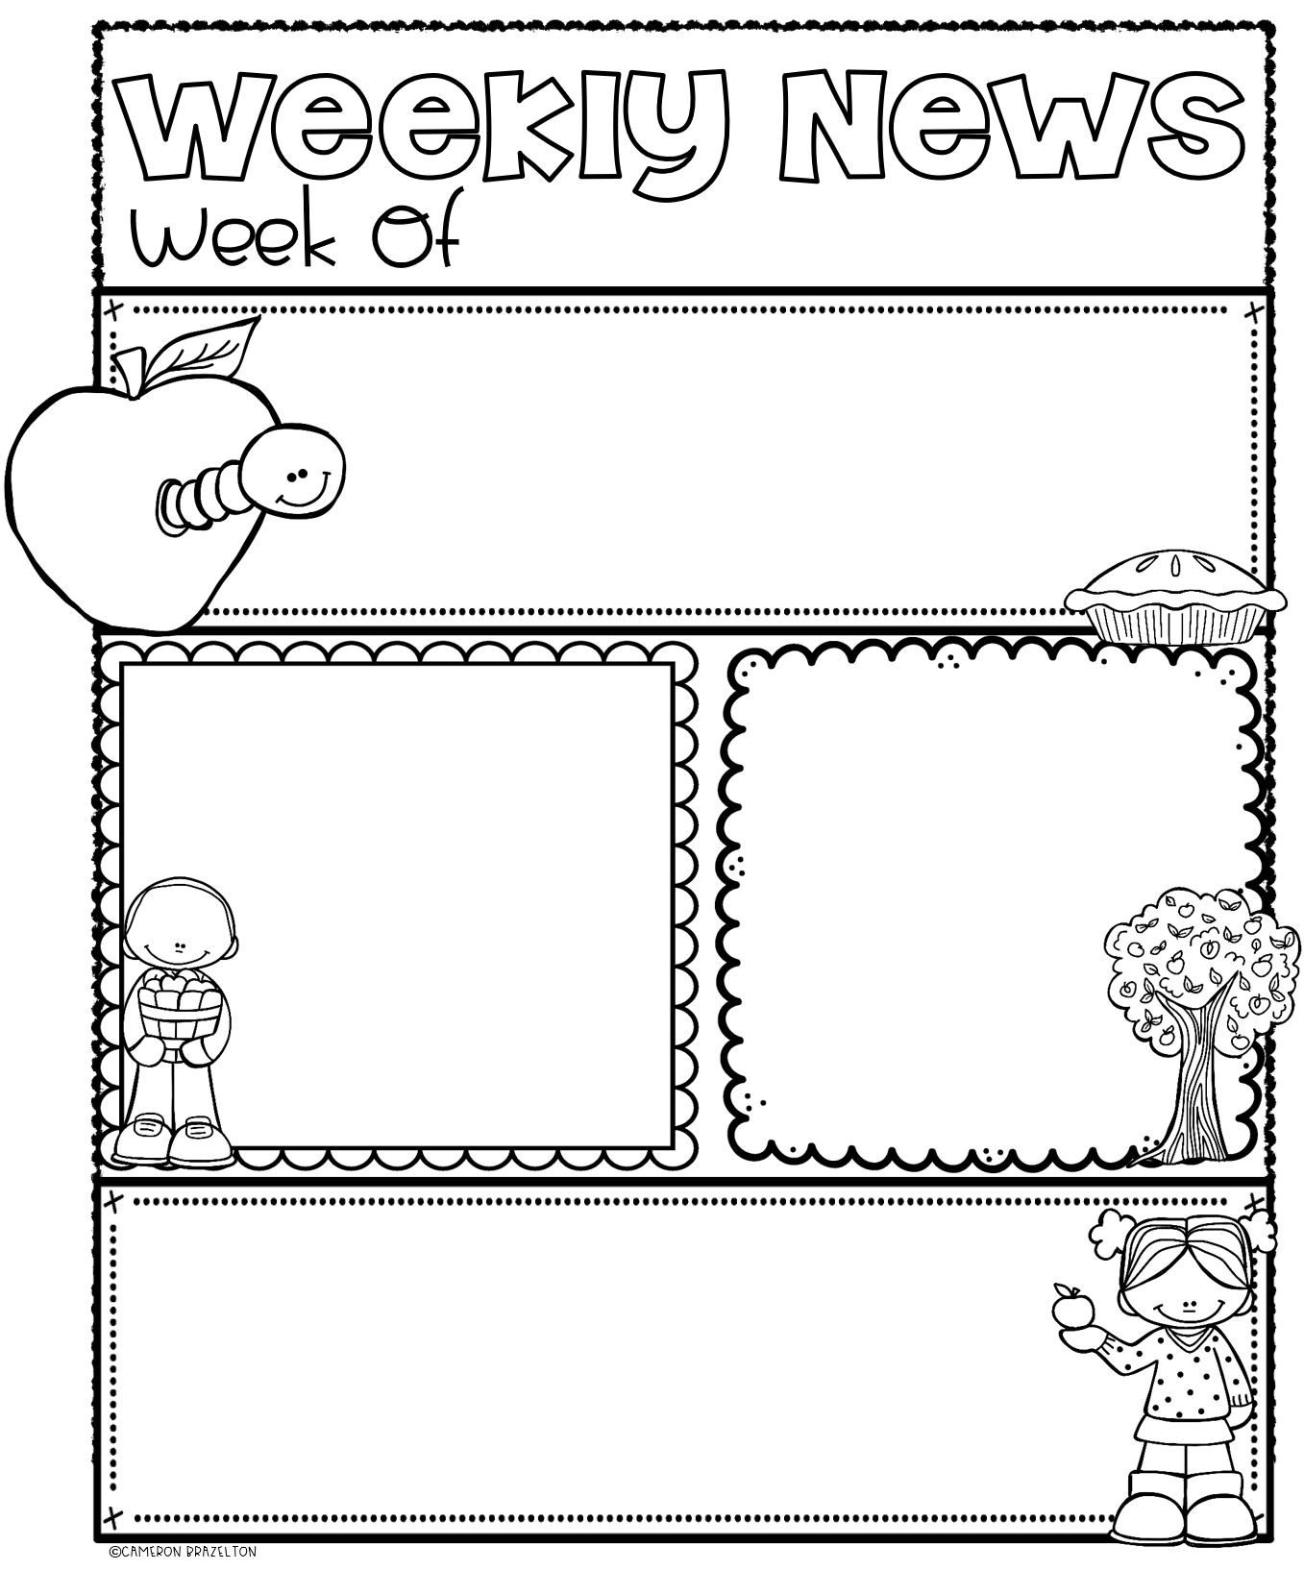
November 18 - 22
EMERGENT READERS ~ REVIEW WEEK
Your child is continuing their Reading journey and it is so exciting to witness! We have learned the letters m, a, s, p, t. That means that your child is beginning to blend those sounds together to make words. This week we will be practicing blending and creating the words am, Sam, Pam, Tam, sap, at, mat, sat, pat, tap. Your child has also learned the sight words: I, can, the, we, see, a, like. This week is review of all the letters/sounds and high-frequency words thus far.
READING
MATH
Our class will be working on Unit 2, Week 3 of our Wonders Reading program. Our theme is “What kind of bugs do you know about?” We will review the uppercase and lowercase letters: Mm, Aa, Ss, Pp, Tt, nouns and verbs, and movement words. We will be reading stories using the high-frequency words: the, can, I, we, see, like, a. We will continue writing stories using illustrations.
This week, our class will collect and represent class data and recognize equal quantities in different arrangements. We will practice numbers that are greater than another number. We will practice addition using kangaroo counters and explore ten frames.
ENRICHMENT SCHEDULE & REMINDERS
Tuesday: Gym (dress down and wear sneakers)
Wednesday: Library *Remember to return library book.
Friday: Computers/iPads
I still have not received all report cards back. Please remember to sign and return report cards from last week. Thank you!

